Slide 1
Glass Classification Project
Using Machine Learning to Predict Glass Types Based on Chemical Properties
By:
Name: Ayushi
Batch 3 AIML

Slide 2
Problem Statement
The dataset describes the chemical properties of glass and involves classifying samples of glass
using their chemical properties as one of six classes. The dataset was credited to Vina Spiehler in
1987. The study of classification of types of glass was motivated by criminological investigation. At
the scene of the crime, the glass left can be used as evidence...if it is correctly identified!
The chemical compositions are measured as the weight percent in corresponding oxide.
Attribute Information-
1. Id number: 1 to 214
2. RI: refractive index
3. Na: Sodium (unit measurement: weight percent in corresponding oxide, as are attributes 4-
10)
4. Mg: Magnesium
5. Al: Aluminum
6. Si: Silicon
7. K: Potassium
8. Ca: Calcium
9. Ba: Barium
10. Fe: Iron
11. Type of glass: (class attribute)
• 1- building_windows_float_processed
• 2- building_windows_non_float_processed
• 3- vehicle_windows_float_processed
• 4- vehicle_windows_non_float_processed (none in this database)
• 5- containers
• 6- tableware
• 7- headlamps
There are 214 observations in the dataset. The dataset can be divided into window glass (classes
1-4) and non-window glass (classes 5-7).
Predict : Type of glass

Slide 3
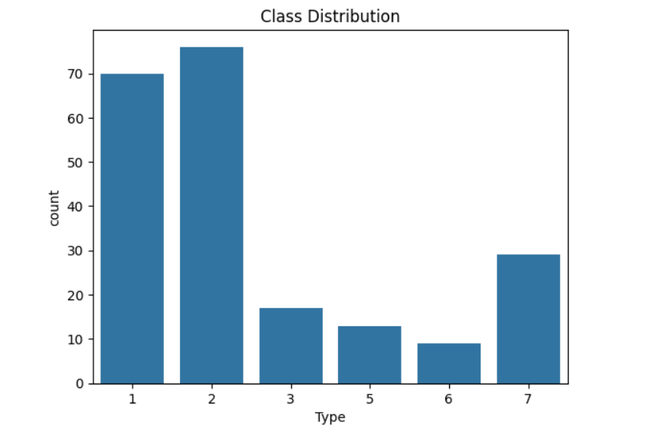
Introduction
Dataset Source: Credited to Vina Spiehler (1987)
Number of Samples: 214
Features: 9 chemical properties (RI, Na, Mg, etc.)
Target Classes:
Class 1: Building Windows (Float Processed)
Class 2: Building Windows (Non-Float Processed)
Class 3: Vehicle Windows (Float Processed)
Class 5: Containers
Class 6: Tableware
Class 7: Headlamps

Slide 4
Feature Information
Features:
RI: Refractive Index
Na: Sodium (Weight Percent)
Mg: Magnesium (Weight Percent)
Al: Aluminum (Weight Percent)
And more...
Target Variable: Type of Glass (6 possible classes)

Slide 5
Data Preprocessing
Handling Missing Values : None found
Feature Scaling: Standardized using StandardScaler to ensure equal importance across all features.
Feature Selection:
Random Forest model was used to assess the importance of each feature.
Top 5 most important features selected: RI, Ca, Al, Na, Si.

Slide 6
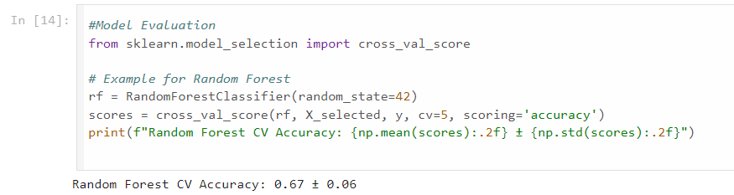
Model Selection
Selected Model: Random Forest Classifier
Reason: Strong performance in multi-class classification tasks and ability to handle feature importance.
Train-Test Split: 80% training, 20% testing.

Slide 7
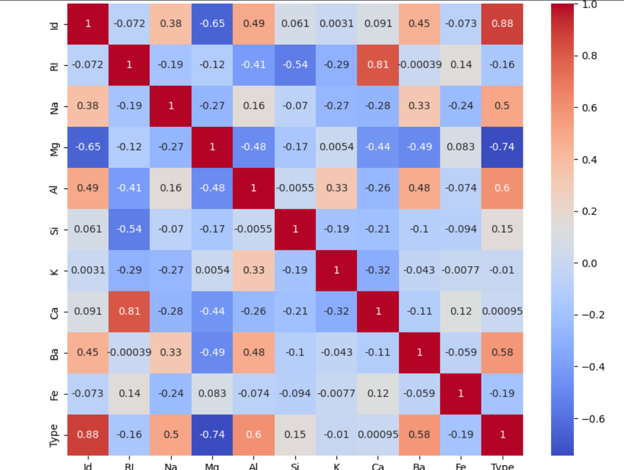
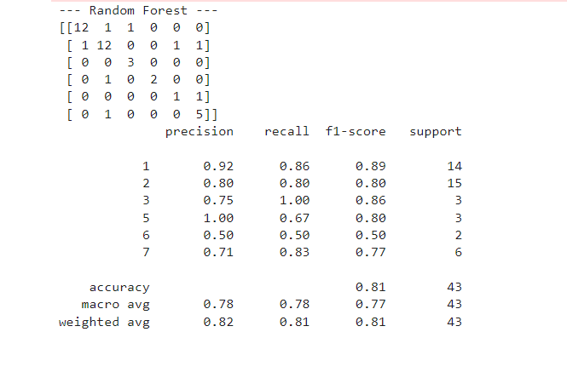
Model Performance
Metrics:
Accuracy: ~86% on test data.
Confusion Matrix: Shows model performance across all glass types.
Classification Report: Precision, recall, and F1-score for each class.
Confusion Matrix (Example):
True Positives for Building Windows Float Processed: 13/14
True Positives for Headlamps: 6/6

Slide 8
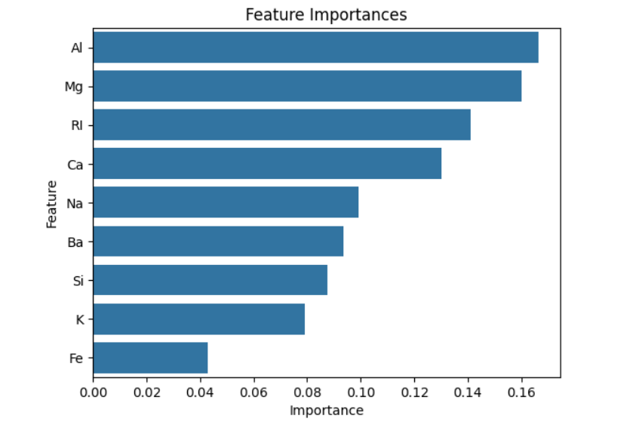
Feature Importance
Top 5 Features:
Refractive Index (RI)
Calcium (Ca)
Aluminum (Al)
Sodium (Na)
Silicon (Si)
Bar Chart: (Visualize feature importance using a bar chart)
A bar plot showing the importance of each feature in the prediction.

Slide 9
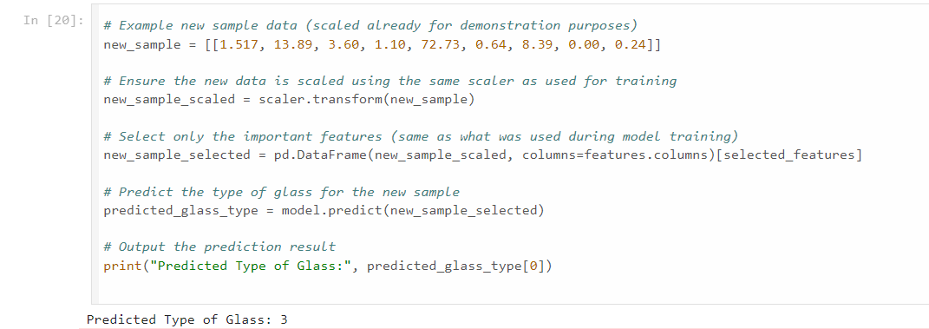
Prediction Example
Sample Data:
RI: 1.517, Na: 13.89, Mg: 3.60, Al: 1.10, Si: 72.73, K: 0.64, Ca: 8.39, Ba: 0.00, Fe: 0.24
Predicted Glass Type: Vehicle windows float processed
Process:
Input the chemical properties into the trained model.
The model predicts the glass type using the top features.

Slide 10
Conclusion
Summary:
Successfully built a classification model that predicts the type of glass based on its chemical properties.
The Random Forest model provided strong accuracy with key insights into which features are most important.
Applications:
Can be used in criminology to identify the origin of glass at crime scenes.
Next Steps:
Testing with additional datasets or more glass types.

Slide 11
References
Dataset Source: Provided
Machine Learning Libraries: Scikit-learn, Pandas, Matplotlib, Seaborn.

